Slide 1
IoT Application
Domain Specific IoTs
Home
Environment
Cities
Notes:
References:
Unit 1 : Arshdeep Bahga, Vijay Madisetti, “Internet of Things, A Hands -on Approach”, 1st Edition 2015, University Press, ISBN: 978-81-7371- 954-7

Slide 2
Domain Specific IoTs
IoT Applications
Home
Smart Lighting
Smart Appliances
Intrusion Detection
Smoke and Gas detectors
Environment
Weather Monitoring
Air Pollution Monitoring
Noise Pollution Monitoring
Forest Fire Detection

Slide 3
Domain Specific IoTs
Cities
Smart Parking
Smart Roads
Structural Health Monitoring
Emergency Response

Slide 4
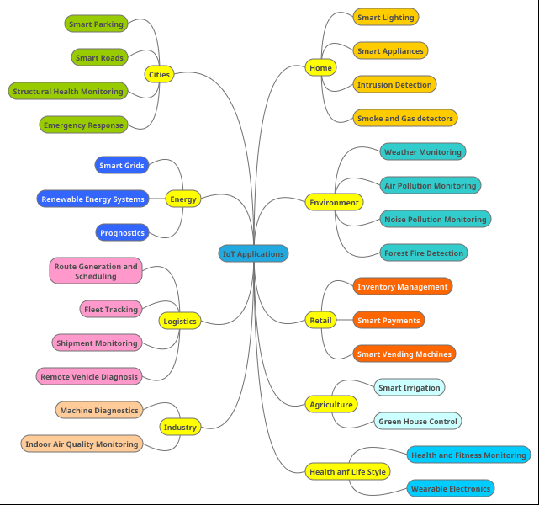
Domain Specific IoTs

Slide 5
Session 5
Domain Specific IoTs
Energy System
Retail
Logistics
Industry
Agriculture
Health & Lifestyle
Instruction: Refer Notes section in every slide for details
Notes:
References:
Unit 1 : Arshdeep Bahga, Vijay Madisetti, “Internet of Things, A Hands -on Approach”, 1st Edition 2015, University Press, ISBN: 978-81-7371- 954-7

Slide 6
Domain Specific IoTs
IoT Applications:
Retail
Inventory Management
Smart Payments
Smart Vending Machines
Agriculture
Smart Irrigation
Green House Control
Health anf Life Style
Health and Fitness Monitoring
Wearable Electronics

Slide 7
Domain Specific IoTs
Energy
Smart Grids
Renewable Energy Systems
Prognostics
Logistics
Route Generation and Scheduling
Fleet Tracking
Shipment Monitoring
Remote Vehicle Diagnosis
Industry
Machine Diagnostics
Indoor Air Quality Monitoring

Slide 8
IoT Applications
IoT applications promise to bring immense value into our lives.
With newer wireless networks, superior sensors and revolutionary computing capabilities, the Internet of Things could be the next frontier in the race for its share of the wallet.
IoT applications are expected to equip billions of everyday objects with connectivity and intelligence.

Slide 9
It is already being deployed extensively, few applications of IoT:
Wearables
Smart Home Applications
Smart Buildings
Smart Infrastructure
Securities
Health Care
Smart Cities
Agriculture
Industrial Automation

Slide 10
IoT Applications: Smart Home, Smart Buildings and Infrastructure
IoT home automation is the ability to control domestic appliances by electronically controlled, internet-connected systems. It may include setting complex heating and lighting systems in advance and setting alarms and home security controls, all connected by a central hub and remote-controlled by a mobile app.

Slide 11
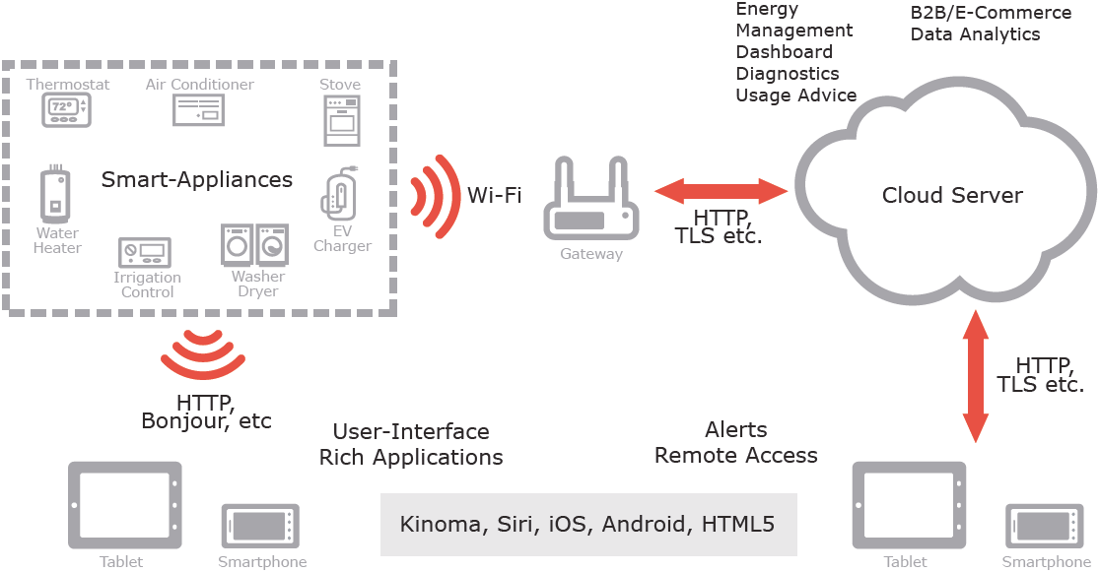
Smart home platform

Slide 12
IoT Applications: Smart Home, Smart Buildings and Infrastructure
The rise of Wi-Fi’s role in home automation has primarily come about due to the networked nature of deployed electronics where electronic devices (TVs and AV receivers, mobile devices, etc.) have started becoming part of the home IP network and due the increasing rate of adoption of mobile computing devices (smartphones, tablets, etc.), see above Figure.
The networking aspects are bringing online streaming services or network playback, while becoming a mean to control of the device functionality over the network. At the same time mobile devices ensure that consumers have access to a portable ‘controller’ for the electronics connected to the network. Both types of devices can be used as gateways for IoT applications. In this context many companies are considering building platforms that
integrate the building automation with entertainment, healthcare monitoring, energy monitoring and wireless sensor monitoring in the home and building environments.
IoT applications using sensors to collect information about the operating conditions combined with cloud hosted analytics software that analyzes disparate data points will help facility managers become far more proactive about managing buildings at peak efficiency.

Slide 13
IoT Applications: Smart Home, Smart Buildings and Infrastructure
Issues of building ownership (i.e., building owner, manager, or occupants)challenge integration with questions such as who pays initial system cost and who collects the benefits over time. A lack of collaboration between the subsectors of the building industry slows new technology adoption and can vent new buildings from achieving energy, economic and environmental performance targets.
Integration of cyber physical systems both within the building and with external entities, such as the electrical grid, will require stakeholder cooperation to achieve true interoperability. As in all sectors, maintaining security will be a critical challenge to overcome.
Within this field of research the exploitation of the potential of wireless sensor networks (WSNs) to facilitate intelligent energy management in buildings, which increases occupant comfort while reducing energy demand, is highly relevant.

Slide 14
IoT Applications: Smart Home, Smart Buildings and Infrastructure
In addition to the obvious economic and environmental gains from the introduction of such intelligent energy management in buildings other positive effects will be achieved. Not least of which is the simplification of building control; as placing monitoring, information feedback equipment and control capabilities in a single location will make a buildings’ energy management system easier to handle for the building owners, building managers, maintenance crews and other users of the building. Using the Internet together with energy management systems also offers an opportunity to access a buildings’ energy information and control systems from a laptop or a Smartphone placed anywhere in the world. This has a huge potential for providing the managers, owners and inhabitants of buildings with energy consumption feedback and the ability to act on that information.
In the context of the future Internet of Things, Intelligent Building Management Systems can be considered part of a much larger information system. This system is used by facilities managers in buildings to manage energy use and energy procurement and to maintain buildings systems. It is based on the infrastructure of the existing Intranets and the Internet, and therefore utilizes the same standards as other IT devices. Within this context reductions in the cost and reliability of WSNs are transforming building automation, by making the maintenance of energy efficient healthy, productive work spaces in buildings increasingly cost effective.

Slide 15
IoT Application in industries

Slide 16

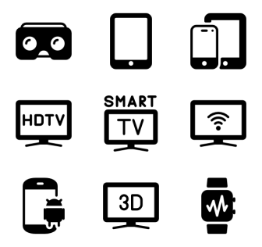


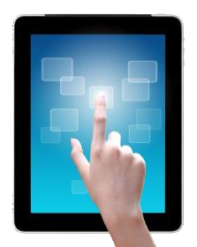
Internet of things (IoT)
Physical
Digital

Slide 17










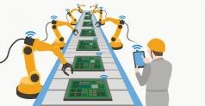
Industrial Internet
of Things (IIoT)
IoT = consumer usage
General usages are
different
IIoT = industrial purposes: manufacturing, supply chain monitor and management system
Both concepts : same main character of availability, intelligent and connected devices.
IIoT uses more sensitive and precise sensors including more location-aware technologies

Slide 18



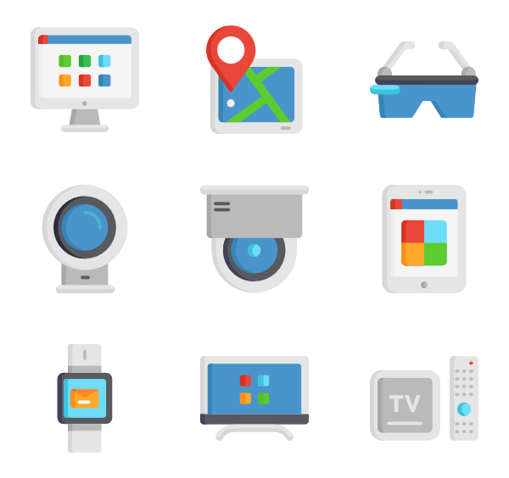
IIoT
IoT
household usage/ for the commercial sector
industrial sector
data management connectivity
data security
secure cloud

Slide 19


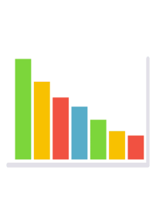
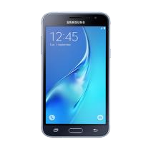

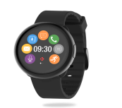
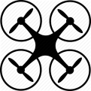

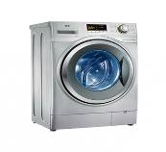






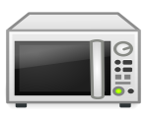
Consumer
Internet of Things
Industrial
Internet of Things
Connectivity Data Analytics

Slide 20
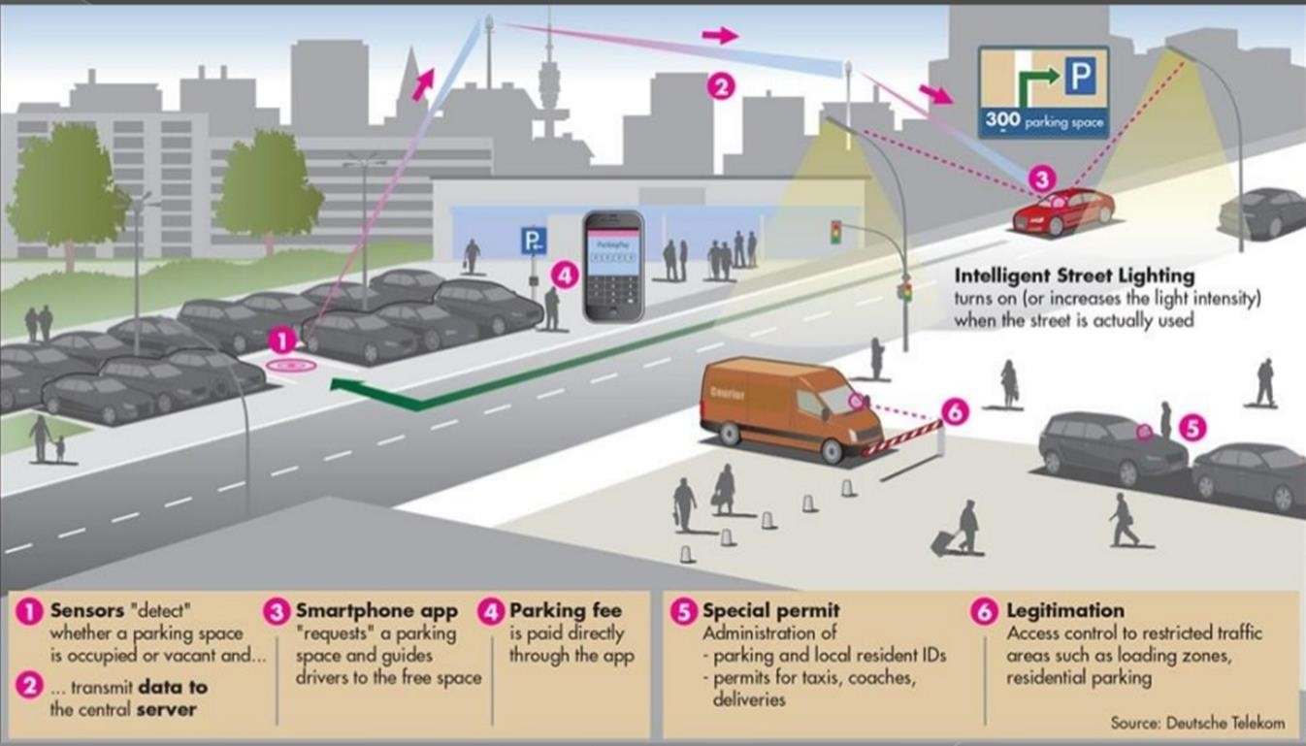
Example of IIoT - Smart Parking

Slide 21
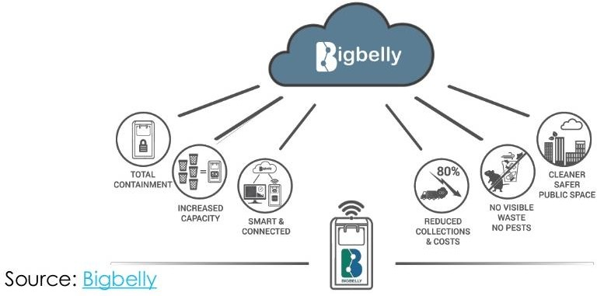
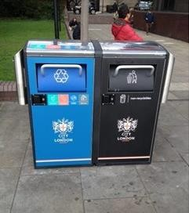
Smart Waste and Recycling

Slide 22
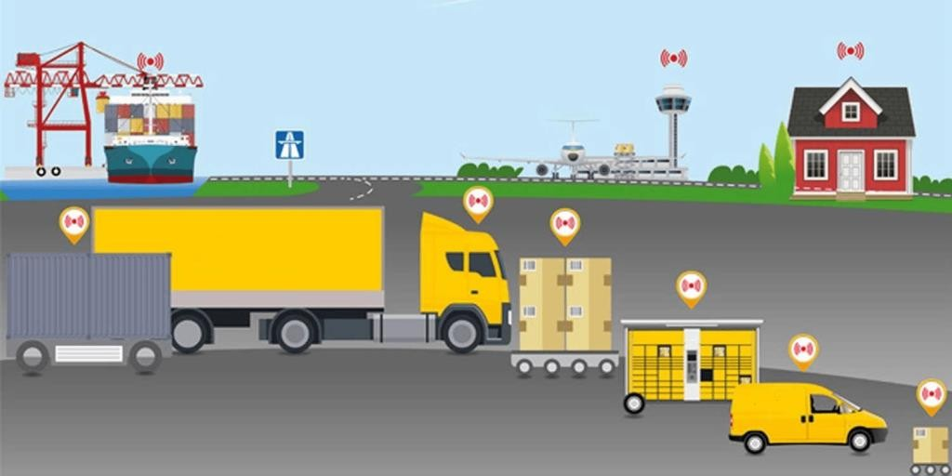
Road, Rail, Air and Sea Logistics
Source: http://blogs.paasmer.co/wp-content/uploads/2017/04/Smart-Transportation-2-Paasmer-1024x512.png

